Slide 1
Tallinn Polytechnic School
Tomi Markus Alber
TA-18E
02.10.2018

Slide 2

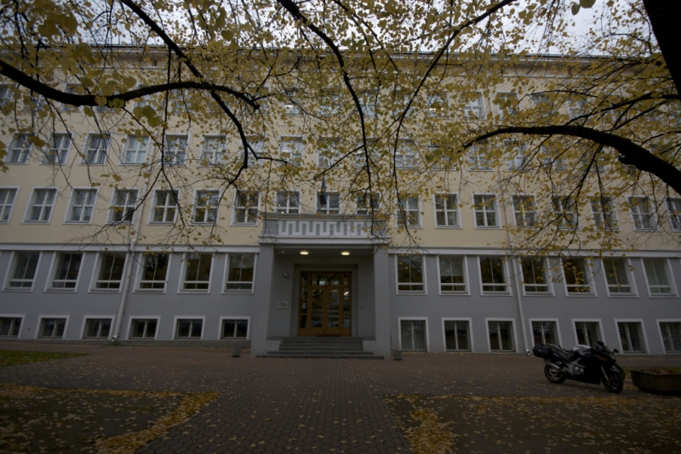
History
One of the oldest technical schools in Estonia
Founded in 1915
since 2004 merged with Tallinn Communication School
It has about 1400 stundents & 100 teachers
The school is 103 years old

Slide 3
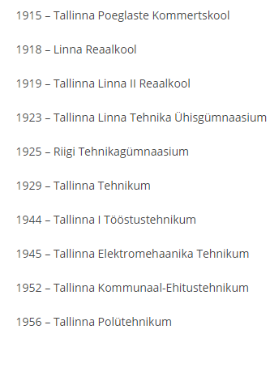
School names

Slide 4
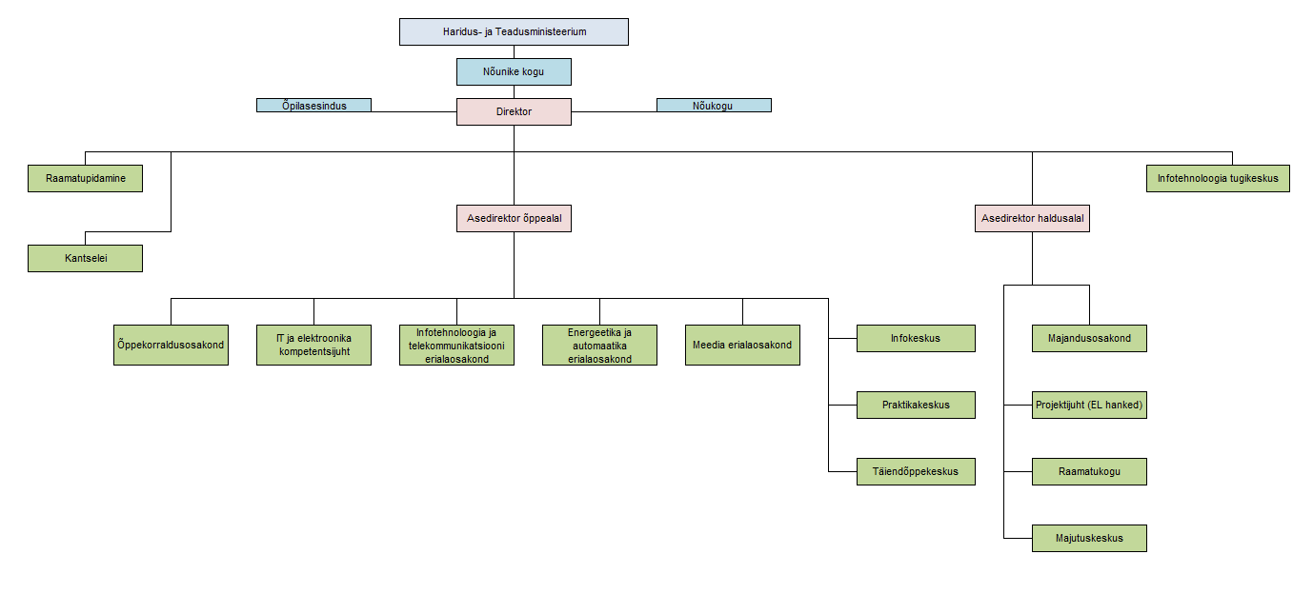
School
School requirements:
logical thinking
good science knowledge
technical sense

Slide 5
Specialities and mission
Mission:
Theoretical and practical skills of their field for for working in firms and Industry
Qualifications for entering universities
Prepares technicians for:
energetics
automatics
telecommunication
computer science
media

Slide 6
Three big departments
IT and TELECOMMUNICATION
Technician of telecommunication devices (3,5 years)
IT specialist (3 years)
Software Developer (2 or 3 years)
Electronics assembly operator (2 years)
ENERGY and AUTOMATION
Electrician (3 years)
Automation (3,5 years)
Weak current installer (3 years)
MEDIA
Printing technology (3 years)
Post print operator
Photography (1,5 years):
TV operaator
TV lighting specialist
Multimedia (web specialist)
(2 years)

Slide 7
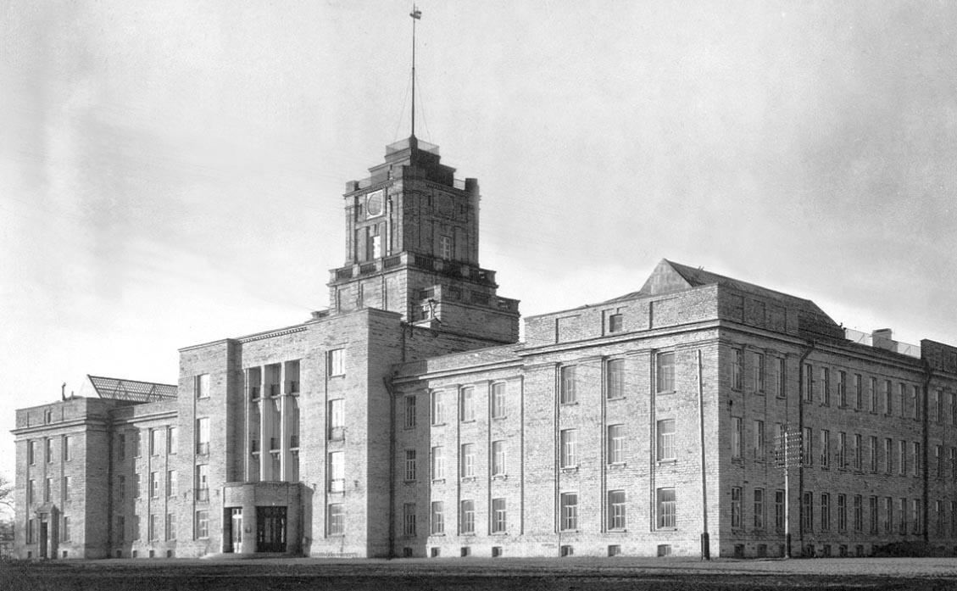
Education system
Most of the programmes last for three and a half years, some take two years.
Secondary education specialities are mostly cycle studies
These students usually come to school once a month for a week or they have lessons every week 2-3 days
School year is dividend into two semesters.
The semester ends with finaal tests or exams.

Slide 8
Basis of Basic and secondary education
Studies may consist of general education studies: (languages, mathematics, natural and social sciences), theoretical studies on subject level and practical job training.
Basis of basic education
At the beginning of studies:
general education
basic professional subjects
Next years:
specialisation
One third of the study time is practical training in school workshops and in various enterprises
Basis of secondary education
speciality subjects
some general subjects:
foreign language and customer service
computer science
basis of enterepreneurship and law
higher mathematics, physics, chemistry etc.

Slide 9
Final certificate
How to get the final certificate:
must pass final exams or defend final work
Possibility to take National Exams
Every year quite many of the students pass National Exams in :
Mother language
Mathematics
English
Official language (Estonian)
and etc.
After receiving final certificate students either take jobs or go to universities.

Slide 10
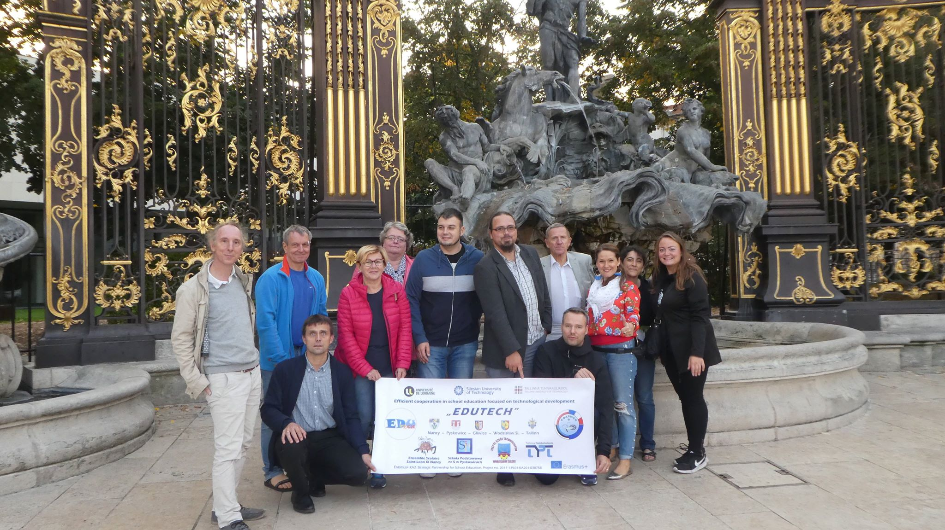
International projects
Contracts with different countries
Free
Good grades

Slide 11
Thank You for listening!

